Slide 1
Designing with Accessibility in Mind
CS130: Tools and Technologies of the World Wide Web

Slide 2
Today’s Class
Intro (5 min)
Survey and/or Consent Form (10 min)
Mini-Lecture (25 min)
Q&A (10 min)
Agenda

Slide 3
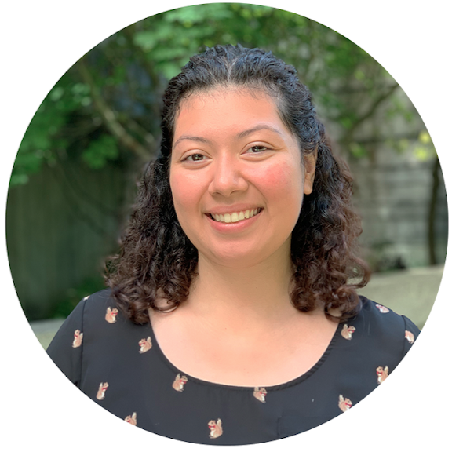
Who am I and Why am I here?
Victoria C. Chávez (they/she)
Computer Science + Learning Sciences PhD Student
Formerly CS Lecturer at University of Rhode Island
Among other things, including HS teacher, software engineer, CTO, freelance web dev
Passionate about CS education, accessibility, equity
Intro
Notes:
End by 4:05

Slide 4
What do you know about accessibility?
Please take this survey (make sure you’re logged in with your @u.northwestern)
It’s okay to say “I don’t know,” we’re trying to gauge where you’re at so we can best shape your accessibility learning experience!
Your answers will not impact your grade.
Please be honest in your responses.
We are interested in knowing how much accessibility knowledge you had BEFORE taking this class.
We'd also like to anonymize and use your survey responses in a research study.
To let us know whether or not you'd like to participate, please fill out this consent form, even if you do not wish to participate.
The consent form allows you to opt out fully or only from certain aspects of the study, whose purpose is to examine and reflect on how to better teach students about accessibility within the software development process.
Participation in the study is completely optional and will not impact your grade in any way.
Survey
Notes:
End by 4:15

Slide 5
Guiding Questions
What is good design?
What are the basic principles of design?
What should I keep in mind as I design my site?
What should I keep in mind as I develop my site?
How can I ensure my sites are accessible to everyone?
Mini-Lecture
Notes:
1/11, end by 4:40

Slide 6
Good Design, in a nutshell
Easy to use
Pleasant to look at
Does not leave user confused
Serves its purpose (to sell, inform, catch someone’s attention, etc.)
Mini-Lecture
Notes:
2/11, end by 4:40

Slide 7
Principles of Design
There are several, depending on who you ask. Let’s focus on:
Balance
Contrast
Emphasis
Proportion
Mini-Lecture
Notes:
3/11, end by 4:40

Slide 8
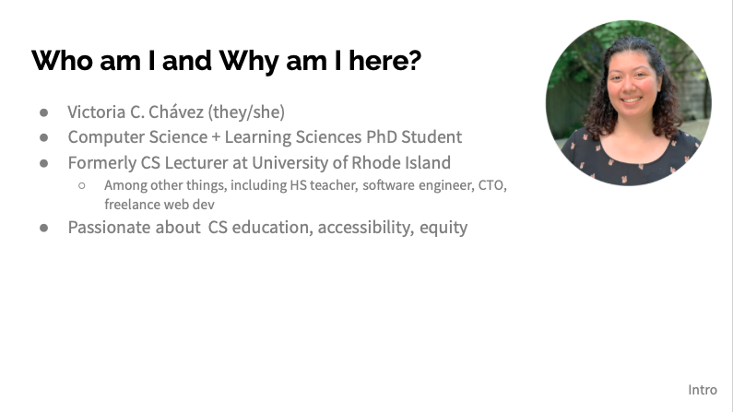
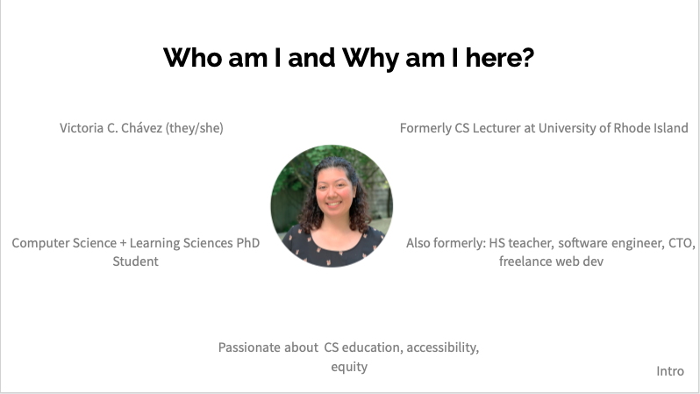
Principles of Design: Balance
Refers to the visual weight elements (images, font types, blocks of color) carry.
A page can be symmetrical or asymmetrical
Should be used to direct user’s attention without confusing or overwhelming
✅
🚫
Notes:
4/11, end by 4:40

Slide 9

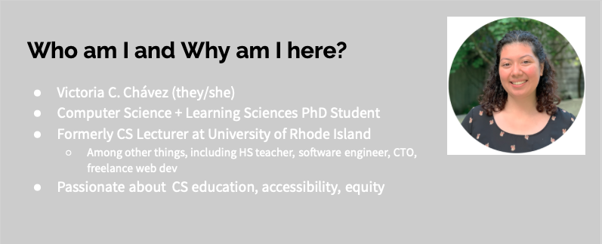
Principles of Design: Contrast
Refers to how elements “pop”
Among others, color, size, and weight can be used to differentiate from nearby elements
High contrast is important for readability, however, too much contrast can be jarring and distracting.
✅
🚫
Notes:
5/11, end by 4:40

Slide 10
Principles of Design: Contrast
Refers to how elements “pop”
Among others, color, size, and weight can be used to differentiate from nearby elements
High contrast is important for readability, however, too much contrast can be jarring and distracting.
✅
🚫
Notes:
6/11, end by 4:40

Slide 11
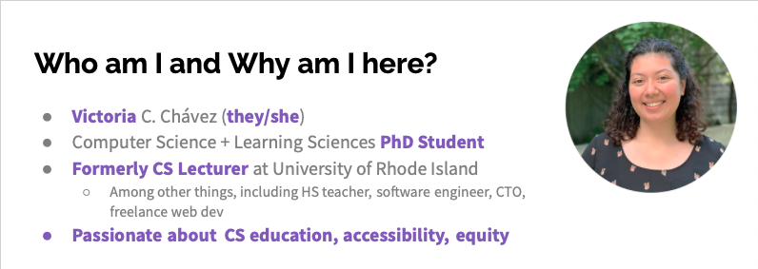
Principles of Design: Emphasis
Refers to anything that makes an element stand out
Similar to contrast, but used strategically to bring someone’s attention to something
Notes:
7/11, end by 4:40

Slide 12
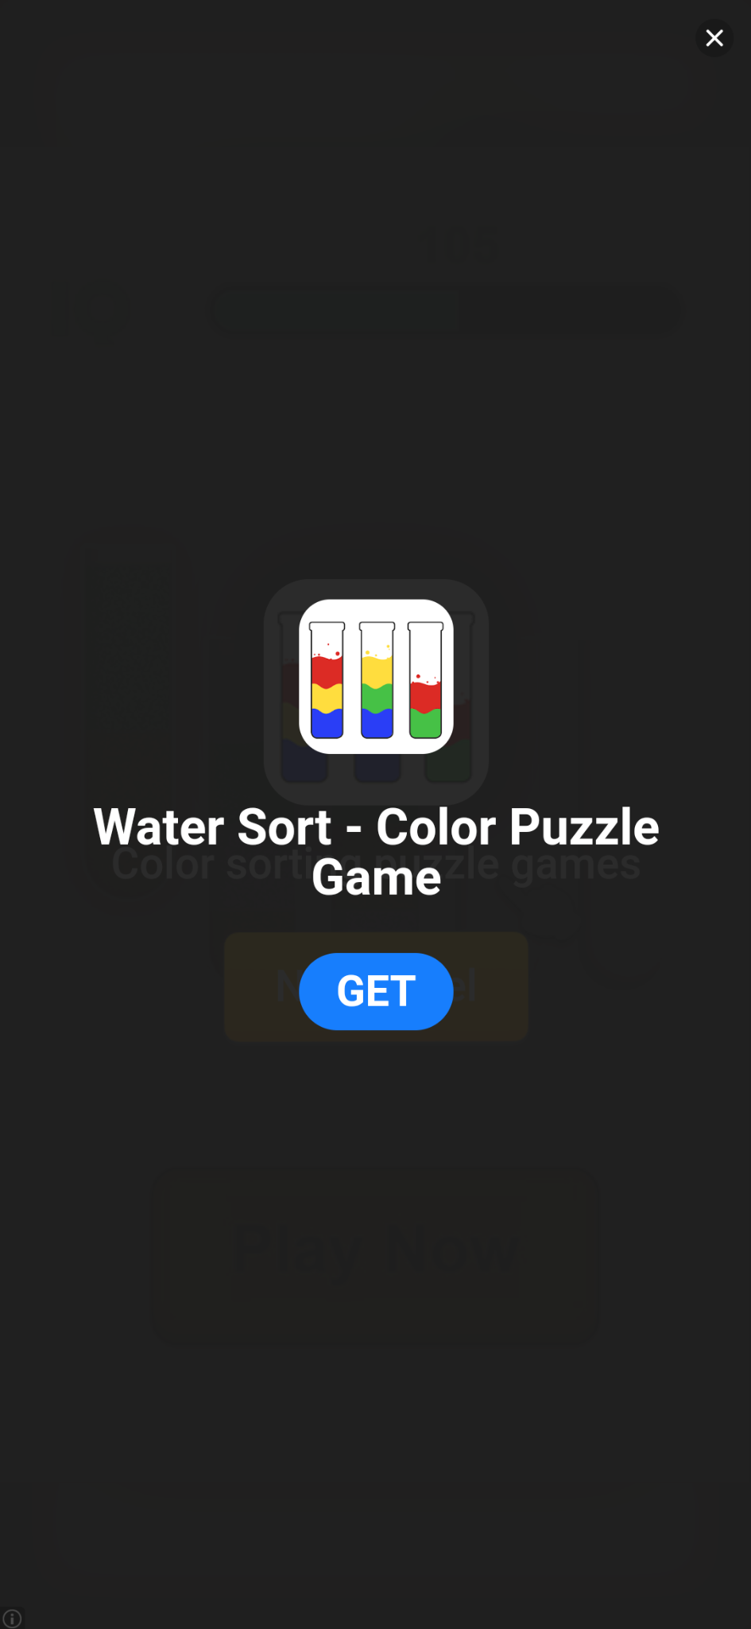
Principles of Design: Proportion
Refers to the size of elements on a page
Should be in relation to elements’ importance
Even less important elements should be reasonably sized!
Even better if your page is easily resizable.
🚫
Mini-Lecture
Notes:
8/11, end by 4:40

Slide 13
Bad Design leads to inaccessible sites
Poor balance may prevent neurodiverse users from easily navigating your site. It can also prevent screen-readers from properly reading a site aloud for blind users
Low or bad contrast prevents color-blind users and low-vision users from accessing your site
Use lightness to build gradients, not just hue
Avoid complementary hues (e.g. red and green, orange and blue) and bright colors for backgrounds.
Misaligned proportions can be confusing and make it difficult for users with mobility issues to access your site
Check out these accessibility posters
Mini-Lecture
Notes:
9/11, end by 4:40

Slide 14
Accessibility Matters!
15% of the world population and 26% of the U.S. population has a disability
20-34 of us on the call
Most of us will become disabled at some point (temporary or permanently)
Usually by way of injury or age-related health conditions
Inaccessibility is illegal
New legal precedent: ADA (Americans with Disabilities Act) applies to websites (Twitter Thread)
Mini-Lecture
Notes:
Source: CDC Disability Impacts All of Us
10/11, end by 4:40

Slide 15
Good design is not necessarily accessible
While bad design is inaccessible, accessibility is more than just good design
Other accessibility considerations include:
Descriptive alt-text and captions for media
Resizable-friendly
Screen-reader friendly
Keyboard-friendly (no mouse)
There’s actually a whole set of standards for web accessibility: Web Content Accessibility Guidelines (WCAG)
Fret not, plenty of accessibility resources are available to help you get started!
Mini-Lecture
Notes:
11/11, end by 4:40

Slide 16
Accessibility beyond looks
Use semantic HTML
Describe tables, graphs, and figures
Write in plain, simple, concise language
Describe images using the alt attribute of the img tag
Always set the language of a webpage (i.e., <html lang="en">)
Use descriptive links (i.e., “accessibility resources”, not “more info here”)

Slide 17
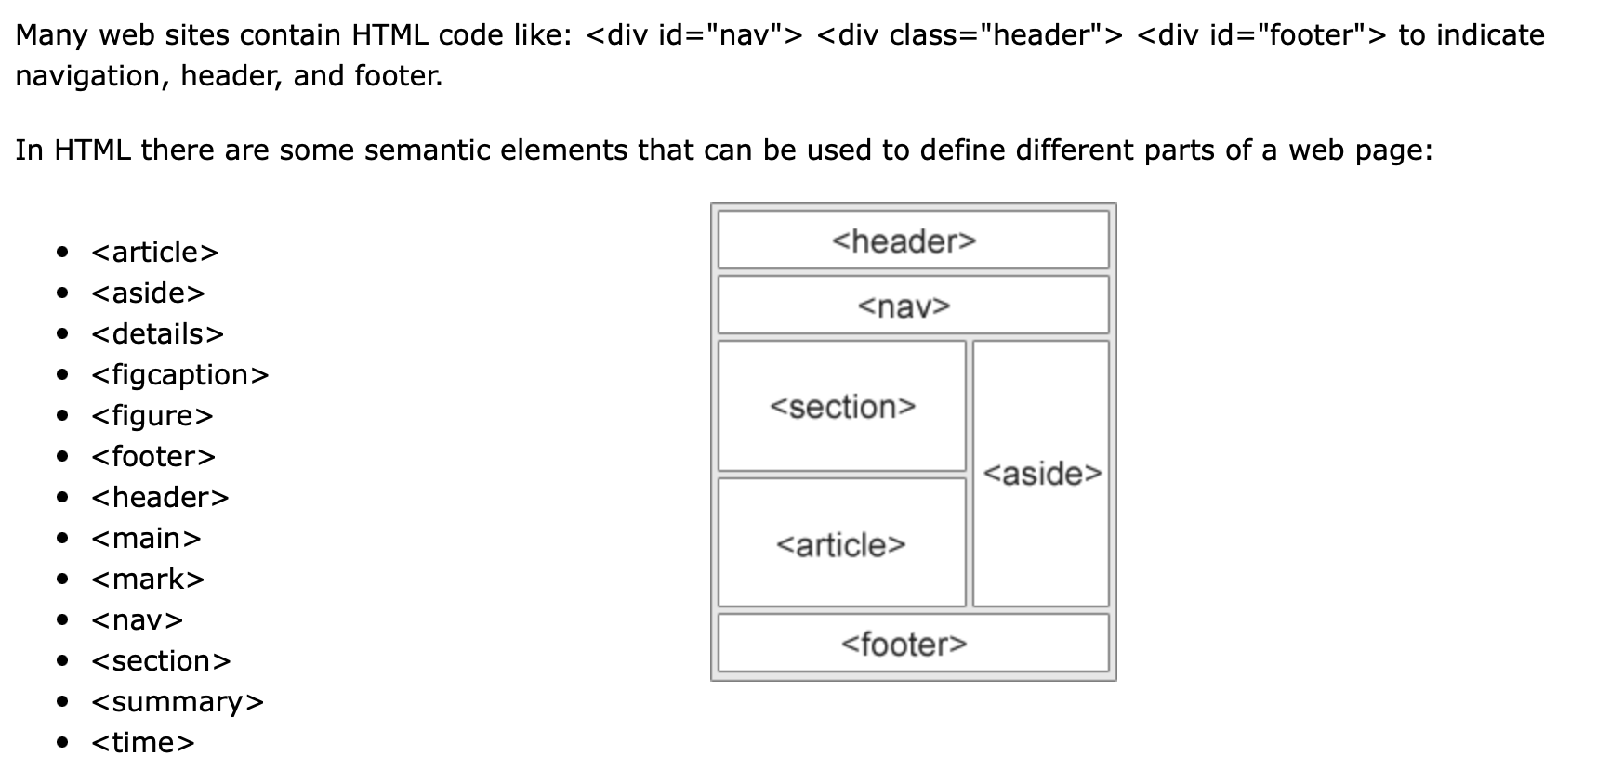
Semantic HTML Example

Slide 18
Questions/thoughts/comments/concerns?
Q&A
Notes:
Class end 4:50

